Slide 1
Linear Regression with multiple variables

Slide 2
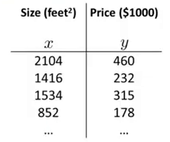

Multiple features (variables)
$$h_{θ}\left(x\right)= θ_{0}+θ_{1}x$$

Slide 3
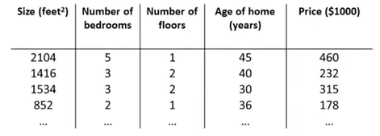
Multiple features (variables)

Slide 4
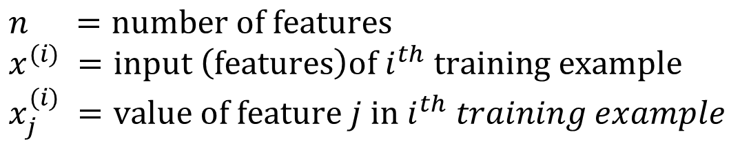
Multiple features (variables)
$$n =number of features$$
$$x^{(i)} =input \left(features\right)of i^{th} training example$$
$$x_{j}^{(i)} =value of feature j in{ i}^{th} training example$$

Slide 5
Multiple features (variables)
4
$$n =number of features$$
$$x^{(i)} =input \left(features\right)of i^{th} training example$$
$$x_{j}^{(i)} =value of feature j in{ i}^{th} training example$$

Slide 6


Multiple features (variables)
4
$$n =number of features$$
$$x^{(i)} =input \left(features\right)of i^{th} training example$$
$$x_{j}^{(i)} =value of feature j in{ i}^{th} training example$$

Slide 7

Multiple features (variables)
$$x^{(2)}$$
4
$$n =number of features$$
$$x^{(i)} =input \left(features\right)of i^{th} training example$$
$$x_{j}^{(i)} =value of feature j in{ i}^{th} training example$$

Slide 8
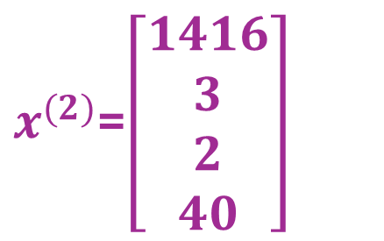
Multiple features (variables)
$x^{(2)}$=$\left[\begin{aligned}1416 \\ 3 \\ 2 \\ 40\end{aligned}\right]$
4
$$n =number of features$$
$$x^{(i)} =input \left(features\right)of i^{th} training example$$
$$x_{j}^{(i)} =value of feature j in{ i}^{th} training example$$

Slide 9

Multiple features (variables)
$x^{(2)}$=$\left[\begin{aligned}1416 \\ 3 \\ 2 \\ 40\end{aligned}\right]$
4
$$n =number of features$$
$$x^{(i)} =input \left(features\right)of i^{th} training example$$
$$x_{j}^{(i)} =value of feature j in{ i}^{th} training example$$

Slide 10

Multiple features (variables)
$x^{(2)}$=$\left[\begin{aligned}1416 \\ 3 \\ 2 \\ 40\end{aligned}\right]$
4
$$n =number of features$$
$$x^{(i)} =input \left(features\right)of i^{th} training example$$
$$x_{j}^{(i)} =value of feature j in{ i}^{th} training example$$
$$x_{3}^{2}=2$$

Slide 11

Hypothesis:
Previously:
$$h_{θ}\left(x\right)= θ_{0}+θ_{1}x$$

Slide 12
Hypothesis:
Previously:
$$h_{θ}\left(x\right)= θ_{0}+θ_{1}x$$
$$h_{θ}\left(x\right)= θ_{0}+θ_{1}x_{1}+θ_{2}x_{2}+θ_{3}x_{3}+θ_{4}x_{4}$$

Slide 13
Hypothesis:
Previously:
$$h_{θ}\left(x\right)= θ_{0}+θ_{1}x$$
$$h_{θ}\left(x\right)= θ_{0}+θ_{1}x_{1}+θ_{2}x_{2}+θ_{3}x_{3}+θ_{4}x_{4}$$
$${e.g. h}_{θ}\left(x\right)=80+0.1x_{1}+0.01x_{2}+3x_{3}−2x_{4}$$

Slide 14
Hypothesis for multivariables
$$h_{θ}\left(x\right)= θ_{0}+θ_{1}x_{1}+θ_{2}x_{2}+ … +θ_{n}x_{n}$$

Slide 15
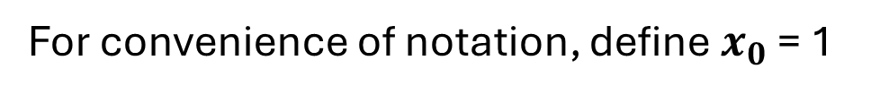
Hypothesis for multivariable
$$h_{θ}\left(x\right)= θ_{0}+θ_{1}x_{1}+θ_{2}x_{2}+ … +θ_{n}x_{n}$$
For convenience of notation, define $x_{0}$ = 1

Slide 16

Hypothesis for multivariable
$$h_{θ}\left(x\right)= θ_{0}+θ_{1}x_{1}+θ_{2}x_{2}+ … +θ_{n}x_{n}$$
For convenience of notation, define $x_{0}$ = 1
$$(x_{0}^{\left(i\right)}=1)$$

Slide 17


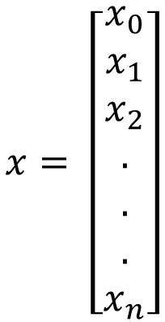
Hypothesis for multivariable
$$h_{θ}\left(x\right)= θ_{0}+θ_{1}x_{1}+θ_{2}x_{2}+ … +θ_{n}x_{n}$$
For convenience of notation, define $x_{0}$ = 1
$$(x_{0}^{\left(i\right)}=1)$$
$$x= \left[\begin{aligned}x_{0} \\ x_{1} \\ x_{2} \\ . \\ . \\ . \\ x_{n}\end{aligned}\right]$$
n+1
$$∈$$

Slide 18
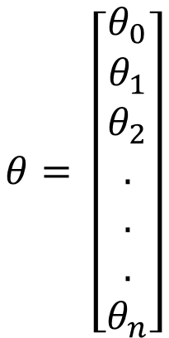

Hypothesis for multivariable
$$h_{θ}\left(x\right)= θ_{0}+θ_{1}x_{1}+θ_{2}x_{2}+ … +θ_{n}x_{n}$$
For convenience of notation, define $x_{0}$ = 1
$$(x_{0}^{\left(i\right)}=1)$$
$$x= \left[\begin{aligned}x_{0} \\ x_{1} \\ x_{2} \\ . \\ . \\ . \\ x_{n}\end{aligned}\right]$$
$$θ= \left[\begin{aligned}θ_{0} \\ θ_{1} \\ θ_{2} \\ . \\ . \\ . \\ θ_{n}\end{aligned}\right]$$
n+1
n+1
$$∈$$
$$∈$$

Slide 19
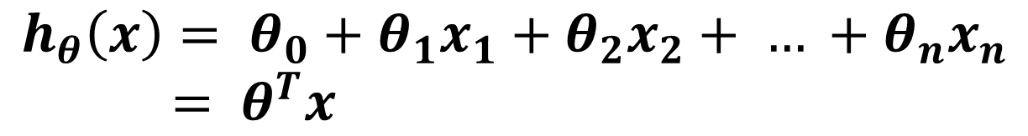
Hypothesis for multivariable
$$h_{θ}\left(x\right)= θ_{0}+θ_{1}x_{1}+θ_{2}x_{2}+ … +θ_{n}x_{n}$$
For convenience of notation, define $x_{0}$ = 1
$$(x_{0}^{\left(i\right)}=1)$$
$$x= \left[\begin{aligned}x_{0} \\ x_{1} \\ x_{2} \\ . \\ . \\ . \\ x_{n}\end{aligned}\right]$$
$$θ= \left[\begin{aligned}θ_{0} \\ θ_{1} \\ θ_{2} \\ . \\ . \\ . \\ θ_{n}\end{aligned}\right]$$
n+1
n+1
$$∈$$
$$∈$$
$$h_{θ}\left(x\right)= θ_{0}+θ_{1}x_{1}+θ_{2}x_{2}+ … +θ_{n}x_{n}$$
$= θ^{T}x$

Slide 20


Hypothesis for multivariable
$$h_{θ}\left(x\right)= θ_{0}+θ_{1}x_{1}+θ_{2}x_{2}+ … +θ_{n}x_{n}$$
For convenience of notation, define $x_{0}$ = 1
$$[θ_{0}{ θ}_{1}{ θ}_{2} …θ_{n}]$$
$$\left[\begin{aligned}x_{0} \\ x_{1} \\ x_{2} \\ . \\ . \\ . \\ x_{n}\end{aligned}\right]$$
$$x= \left[\begin{aligned}x_{0} \\ x_{1} \\ x_{2} \\ . \\ . \\ . \\ x_{n}\end{aligned}\right]$$
$$θ= \left[\begin{aligned}θ_{0} \\ θ_{1} \\ θ_{2} \\ . \\ . \\ . \\ θ_{n}\end{aligned}\right]$$
n+1
n+1
$$∈$$
$$∈$$
$$h_{θ}\left(x\right)= θ_{0}+θ_{1}x_{1}+θ_{2}x_{2}+ … +θ_{n}x_{n}$$
$= θ^{T}x$

Slide 21

Hypothesis for multivariable
$$h_{θ}\left(x\right)= θ_{0}+θ_{1}x_{1}+θ_{2}x_{2}+ … +θ_{n}x_{n}$$
For convenience of notation, define $x_{0}$ = 1
$$[θ_{0}{ θ}_{1}{ θ}_{2} …θ_{n}]$$
$$\left[\begin{aligned}x_{0} \\ x_{1} \\ x_{2} \\ . \\ . \\ . \\ x_{n}\end{aligned}\right]$$
$$x= \left[\begin{aligned}x_{0} \\ x_{1} \\ x_{2} \\ . \\ . \\ . \\ x_{n}\end{aligned}\right]$$
$$θ= \left[\begin{aligned}θ_{0} \\ θ_{1} \\ θ_{2} \\ . \\ . \\ . \\ θ_{n}\end{aligned}\right]$$
n+1
n+1
$$θ^{T}x$$
$$∈$$
$$∈$$
$$h_{θ}\left(x\right)= θ_{0}+θ_{1}x_{1}+θ_{2}x_{2}+ … +θ_{n}x_{n}$$
$= θ^{T}x$

Slide 22
Hypothesis for multivariable
$$h_{θ}\left(x\right)= θ_{0}+θ_{1}x_{1}+θ_{2}x_{2}+ … +θ_{n}x_{n}$$
For convenience of notation, define $x_{0}$ = 1
$$[θ_{0}{ θ}_{1}{ θ}_{2} …θ_{n}]$$
$$\left[\begin{aligned}x_{0} \\ x_{1} \\ x_{2} \\ . \\ . \\ . \\ x_{n}\end{aligned}\right]$$
$$x= \left[\begin{aligned}x_{0} \\ x_{1} \\ x_{2} \\ . \\ . \\ . \\ x_{n}\end{aligned}\right]$$
$$θ= \left[\begin{aligned}θ_{0} \\ θ_{1} \\ θ_{2} \\ . \\ . \\ . \\ θ_{n}\end{aligned}\right]$$
n+1
n+1
$$θ^{T}x$$
$$∈$$
$$∈$$
$$h_{θ}\left(x\right)= θ_{0}+θ_{1}x_{1}+θ_{2}x_{2}+ … +θ_{n}x_{n}$$
$= θ^{T}x$
Multi-variate Linear Regression

Slide 23
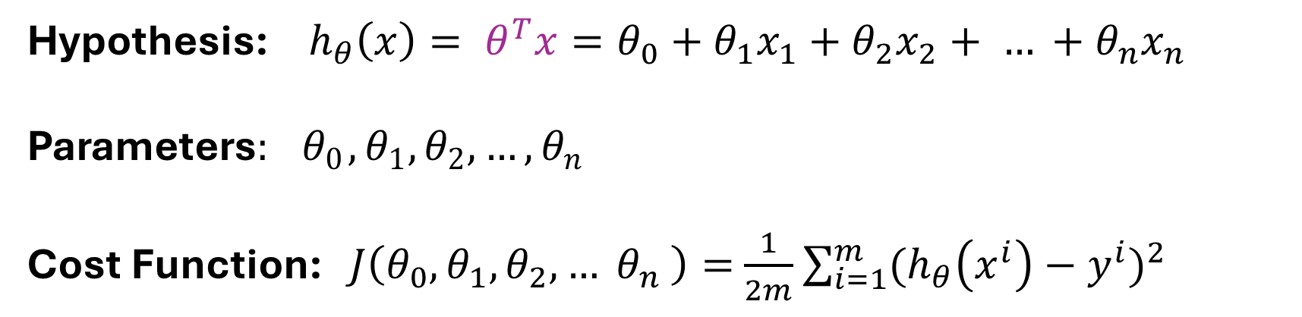
Hypothesis: ${ h}_{θ}\left(x\right)= {θ^{T}x=θ}_{0}+θ_{1}x_{1}+θ_{2}x_{2}+ … +θ_{n}x_{n}$
Parameters$: { θ}_{0}, θ_{1},θ_{2}, …, θ_{n}$
Cost Function: $J\left(θ_{0},θ_{1}, θ_{2},… θ_{n} \right)=$ $\frac{1}{2m}$ $\sum_{i=1}^{m}{{(h_{θ}\left(x^{i}\right)−y^{i})}^{2}}$

Slide 24
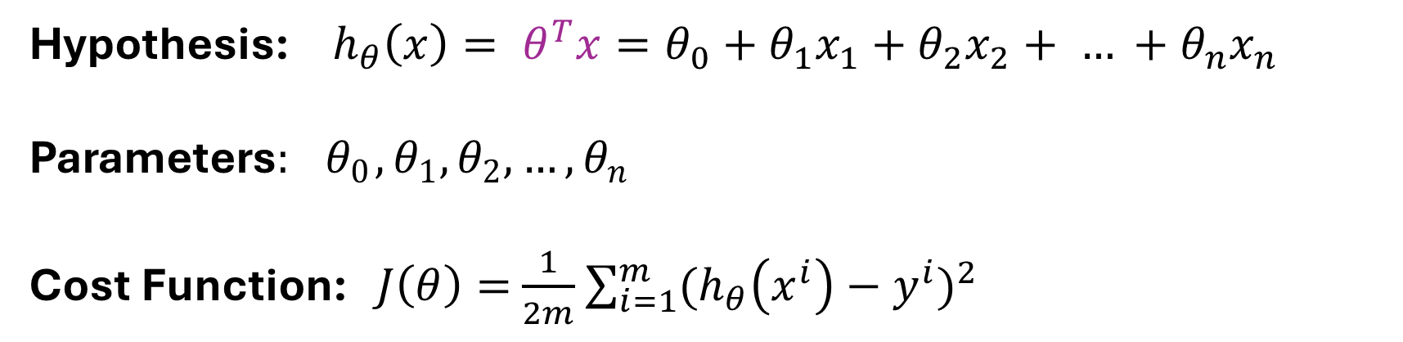
Hypothesis: ${ h}_{θ}\left(x\right)= {θ^{T}x=θ}_{0}+θ_{1}x_{1}+θ_{2}x_{2}+ … +θ_{n}x_{n}$
Parameters$: { θ}_{0}, θ_{1},θ_{2}, …, θ_{n}$
Cost Function: $J\left(θ\right)=$ $\frac{1}{2m}$ $\sum_{i=1}^{m}{{(h_{θ}\left(x^{i}\right)−y^{i})}^{2}}$

Slide 25
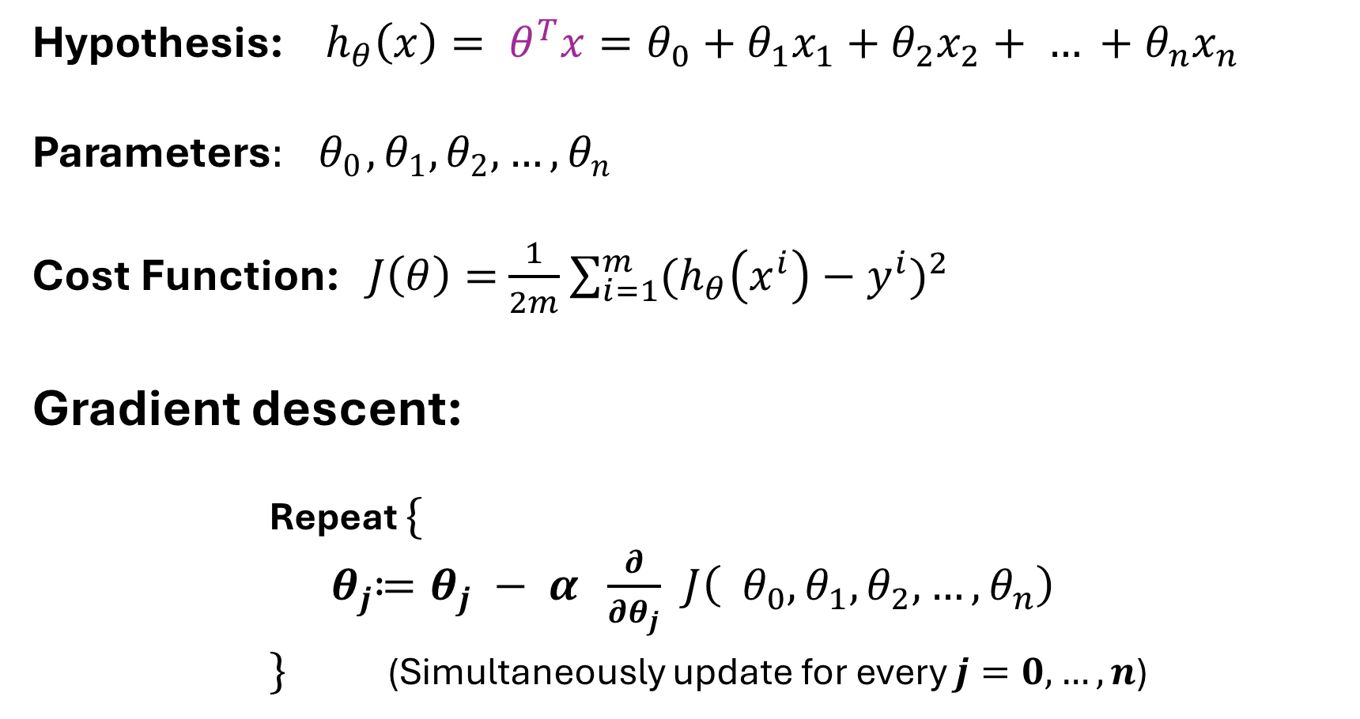
Hypothesis: ${ h}_{θ}\left(x\right)= {θ^{T}x=θ}_{0}+θ_{1}x_{1}+θ_{2}x_{2}+ … +θ_{n}x_{n}$
Parameters$: { θ}_{0}, θ_{1},θ_{2}, …, θ_{n}$
Cost Function: $J\left(θ\right)=$ $\frac{1}{2m}$ $\sum_{i=1}^{m}{{(h_{θ}\left(x^{i}\right)−y^{i})}^{2}}$
Gradient descent:
Repeat $\{$
${ θ}_{j}≔θ_{j} − α \frac{∂}{∂θ_{j}} J\left({ θ}_{0}, θ_{1},θ_{2}, …, θ_{n}\right)$
$\}$ (Simultaneously update for every $j=0,…, n$)

Slide 26

Hypothesis: ${ h}_{θ}\left(x\right)= {θ^{T}x=θ}_{0}+θ_{1}x_{1}+θ_{2}x_{2}+ … +θ_{n}x_{n}$
Parameters$: { θ}_{0}, θ_{1},θ_{2}, …, θ_{n}$
Cost Function: $J\left(θ\right)=$ $\frac{1}{2m}$ $\sum_{i=1}^{m}{{(h_{θ}\left(x^{i}\right)−y^{i})}^{2}}$
Gradient descent:
Repeat $\{$
${ θ}_{j}≔θ_{j} − α \frac{∂}{∂θ_{j}} J\left({ θ}_{0}, θ_{1},θ_{2}, …, θ_{n}\right)$
$\}$ (Simultaneously update for every $j=0,…, n$)
$$J\left(θ\right)$$

Slide 27
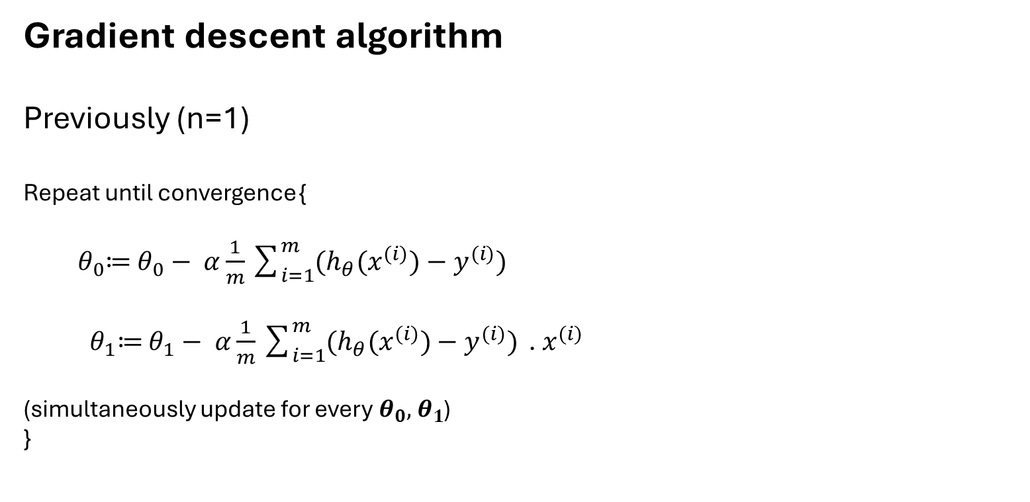
Gradient descent algorithm
Previously (n=1)
Repeat until convergence {
${ θ}_{0}≔$ $θ_{0}− α\frac{1}{m}\sum_{i=1}^{m}{(h_{θ}(x^{(i)})−y^{(i)})}$
${ θ}_{1}≔$ $θ_{1}− α\frac{1}{m}\sum_{i=1}^{m}{(h_{θ}(x^{(i)})−y^{(i)})}\text{ . }x^{(i)}$
(simultaneously update for every${ θ}_{0},{ θ}_{1}$)
}

Slide 28
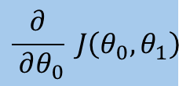
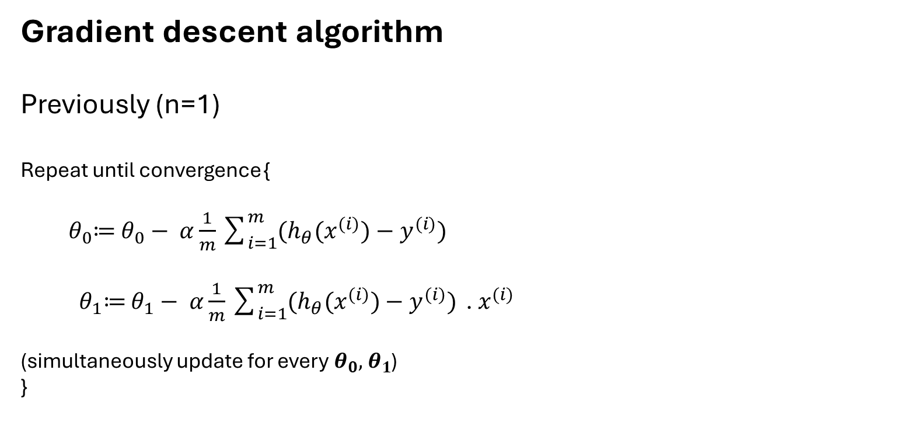
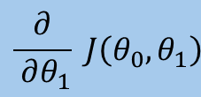
Gradient descent algorithm
Previously (n=1)
Repeat until convergence {
${ θ}_{0}≔$ $θ_{0}− α\frac{1}{m}\sum_{i=1}^{m}{(h_{θ}(x^{(i)})−y^{(i)})}$
${ θ}_{1}≔$ $θ_{1}− α\frac{1}{m}\sum_{i=1}^{m}{(h_{θ}(x^{(i)})−y^{(i)})}\text{ . }x^{(i)}$
(simultaneously update for every${ θ}_{0},{ θ}_{1}$)
}
$$\frac{∂}{ ∂θ_{0}} J\left(θ_{0},θ_{1}\right)$$
$$\frac{∂}{ ∂θ_{1}} J\left(θ_{0},θ_{1}\right)$$

Slide 29
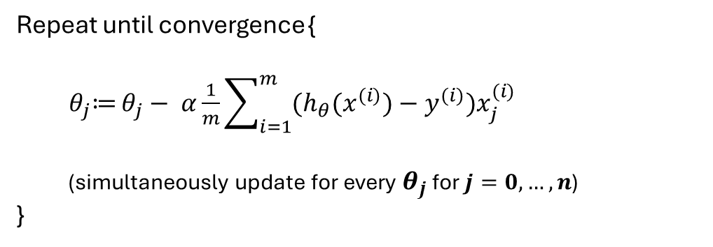
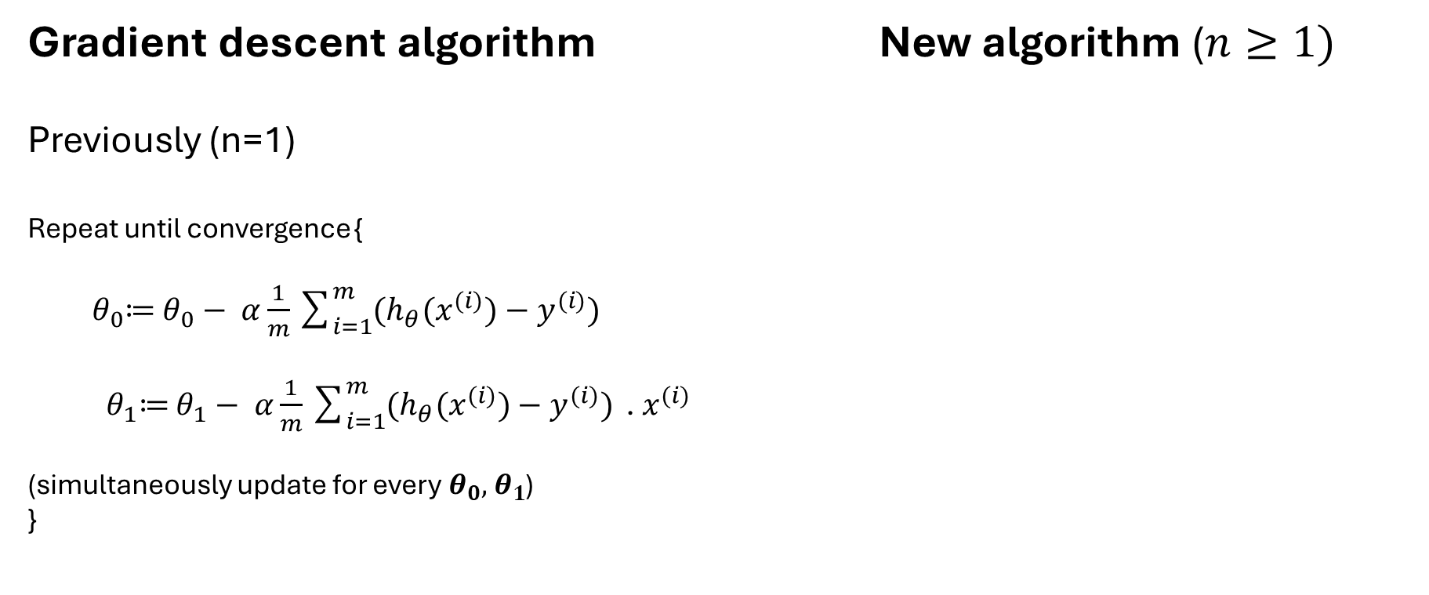
Gradient descent algorithm New algorithm ($n≥1)$
Previously (n=1)
Repeat until convergence {
${ θ}_{0}≔$ $θ_{0}− α\frac{1}{m}\sum_{i=1}^{m}{(h_{θ}(x^{(i)})−y^{(i)})}$
${ θ}_{1}≔$ $θ_{1}− α\frac{1}{m}\sum_{i=1}^{m}{(h_{θ}(x^{(i)})−y^{(i)})}\text{ . }x^{(i)}$
(simultaneously update for every${ θ}_{0},{ θ}_{1}$)
}
Repeat until convergence {
${ θ}_{j}≔$ $θ_{j}− α\frac{1}{m}\sum_{i=1}^{m}{(h_{θ}(x^{(i)})−y^{(i)})x_{j}^{(i)}}$
(simultaneously update for every${ θ}_{j}$ for $j=0,…, n$)
}

Slide 30

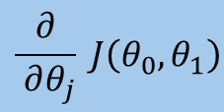
Gradient descent algorithm New algorithm ($n≥1)$
Previously (n=1)
Repeat until convergence {
${ θ}_{0}≔$ $θ_{0}− α\frac{1}{m}\sum_{i=1}^{m}{(h_{θ}(x^{(i)})−y^{(i)})}$
${ θ}_{1}≔$ $θ_{1}− α\frac{1}{m}\sum_{i=1}^{m}{(h_{θ}(x^{(i)})−y^{(i)})}\text{ . }x^{(i)}$
(simultaneously update for every${ θ}_{0},{ θ}_{1}$)
}
Repeat until convergence {
${ θ}_{j}≔$ $θ_{j}− α\frac{1}{m}\sum_{i=1}^{m}{(h_{θ}(x^{(i)})−y^{(i)})x_{j}^{(i)}}$
(simultaneously update for every${ θ}_{j}$ for $j=0,…, n$)
}
$$\frac{∂}{ ∂θ_{j}} J\left(θ_{0},θ_{1}\right)$$

Slide 31
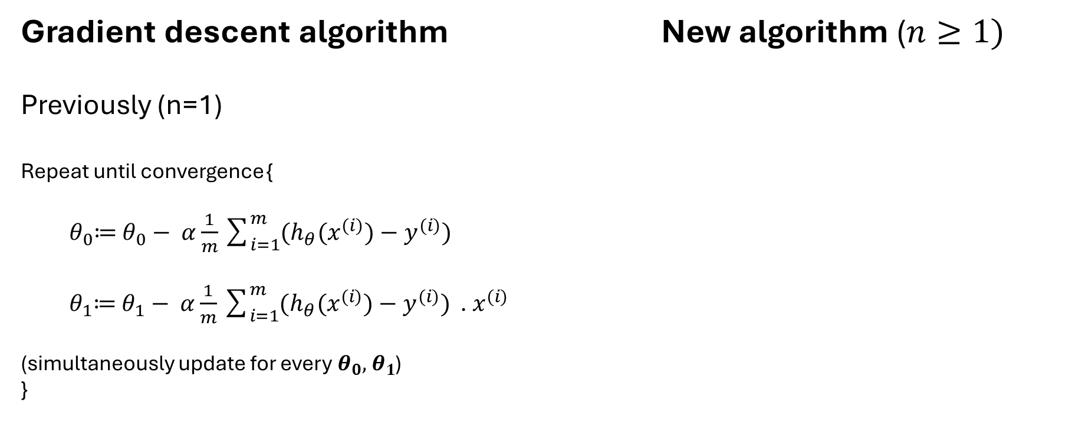

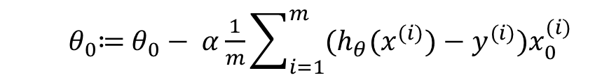
Gradient descent algorithm New algorithm ($n≥1)$
Previously (n=1)
Repeat until convergence {
${ θ}_{0}≔$ $θ_{0}− α\frac{1}{m}\sum_{i=1}^{m}{(h_{θ}(x^{(i)})−y^{(i)})}$
${ θ}_{1}≔$ $θ_{1}− α\frac{1}{m}\sum_{i=1}^{m}{(h_{θ}(x^{(i)})−y^{(i)})}\text{ . }x^{(i)}$
(simultaneously update for every${ θ}_{0},{ θ}_{1}$)
}
Repeat until convergence {
${ θ}_{j}≔$ $θ_{j}− α\frac{1}{m}\sum_{i=1}^{m}{(h_{θ}(x^{(i)})−y^{(i)})x_{j}^{(i)}}$
(simultaneously update for every${ θ}_{j}$ for $j=0,…, n$)
}
${ θ}_{0}≔$ $θ_{0}− α\frac{1}{m}\sum_{i=1}^{m}{(h_{θ}(x^{(i)})−y^{(i)})x_{0}^{(i)}}$
$$θ_{0}$$

Slide 32
Gradient descent algorithm New algorithm ($n≥1)$
Previously (n=1)
Repeat until convergence {
${ θ}_{0}≔$ $θ_{0}− α\frac{1}{m}\sum_{i=1}^{m}{(h_{θ}(x^{(i)})−y^{(i)})}$
${ θ}_{1}≔$ $θ_{1}− α\frac{1}{m}\sum_{i=1}^{m}{(h_{θ}(x^{(i)})−y^{(i)})}\text{ . }x^{(i)}$
(simultaneously update for every${ θ}_{0},{ θ}_{1}$)
}
Repeat until convergence {
${ θ}_{j}≔$ $θ_{j}− α\frac{1}{m}\sum_{i=1}^{m}{(h_{θ}(x^{(i)})−y^{(i)})x_{j}^{(i)}}$
(simultaneously update for every${ θ}_{j}$ for $j=0,…, n$)
}
${ θ}_{0}≔$ $θ_{0}− α\frac{1}{m}\sum_{i=1}^{m}{(h_{θ}(x^{(i)})−y^{(i)})x_{0}^{(i)}}$
$$θ_{0}$$

Slide 33

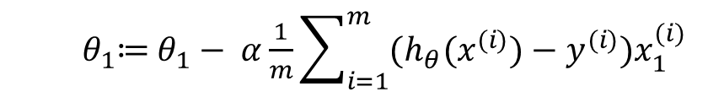
Gradient descent algorithm New algorithm ($n≥1)$
Previously (n=1)
Repeat until convergence {
${ θ}_{0}≔$ $θ_{0}− α\frac{1}{m}\sum_{i=1}^{m}{(h_{θ}(x^{(i)})−y^{(i)})}$
${ θ}_{1}≔$ $θ_{1}− α\frac{1}{m}\sum_{i=1}^{m}{(h_{θ}(x^{(i)})−y^{(i)})}\text{ . }x^{(i)}$
(simultaneously update for every${ θ}_{0},{ θ}_{1}$)
}
Repeat until convergence {
${ θ}_{j}≔$ $θ_{j}− α\frac{1}{m}\sum_{i=1}^{m}{(h_{θ}(x^{(i)})−y^{(i)})x_{j}^{(i)}}$
(simultaneously update for every${ θ}_{j}$ for $j=0,…, n$)
}
${ θ}_{0}≔$ $θ_{0}− α\frac{1}{m}\sum_{i=1}^{m}{(h_{θ}(x^{(i)})−y^{(i)})x_{0}^{(i)}}$
$$θ_{0}$$
${ θ}_{1}≔$ $θ_{1}− α\frac{1}{m}\sum_{i=1}^{m}{(h_{θ}(x^{(i)})−y^{(i)})x_{1}^{(i)}}$
$$θ_{1}$$

Slide 34
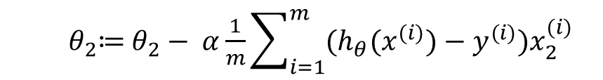

Gradient descent algorithm New algorithm ($n≥1)$
Previously (n=1)
Repeat until convergence {
${ θ}_{0}≔$ $θ_{0}− α\frac{1}{m}\sum_{i=1}^{m}{(h_{θ}(x^{(i)})−y^{(i)})}$
${ θ}_{1}≔$ $θ_{1}− α\frac{1}{m}\sum_{i=1}^{m}{(h_{θ}(x^{(i)})−y^{(i)})}\text{ . }x^{(i)}$
(simultaneously update for every${ θ}_{0},{ θ}_{1}$)
}
Repeat until convergence {
${ θ}_{j}≔$ $θ_{j}− α\frac{1}{m}\sum_{i=1}^{m}{(h_{θ}(x^{(i)})−y^{(i)})x_{j}^{(i)}}$
(simultaneously update for every${ θ}_{j}$ for $j=0,…, n$)
}
${ θ}_{0}≔$ $θ_{0}− α\frac{1}{m}\sum_{i=1}^{m}{(h_{θ}(x^{(i)})−y^{(i)})x_{0}^{(i)}}$
$$θ_{0}$$
${ θ}_{1}≔$ $θ_{1}− α\frac{1}{m}\sum_{i=1}^{m}{(h_{θ}(x^{(i)})−y^{(i)})x_{1}^{(i)}}$
$$θ_{1}$$
${ θ}_{2}≔$ $θ_{2}− α\frac{1}{m}\sum_{i=1}^{m}{(h_{θ}(x^{(i)})−y^{(i)})x_{2}^{(i)}}$
$$θ_{2}$$

Slide 35
Linear Regression with multiple variables
Gradient descent in practice: Features Scaling

Slide 36

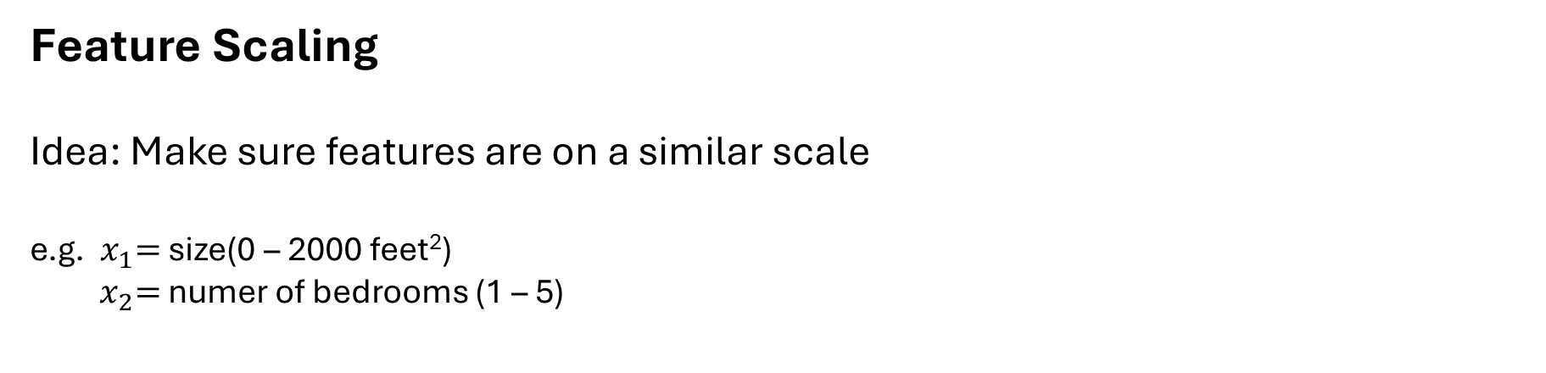


Feature Scaling
Idea: Make sure features are on a similar scale
e.g. ${ x}_{1}=$ size(0 – 2000 feet²)
${ x}_{2}=$ numer of bedrooms (1 – 5)
$${ θ}_{2}$$
$$J(θ)$$
$${ θ}_{1}$$

Slide 37
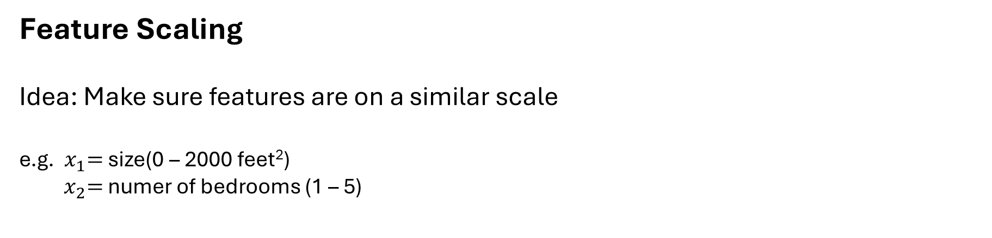

Feature Scaling
Idea: Make sure features are on a similar scale
e.g. ${ x}_{1}=$ size(0 – 2000 feet²)
${ x}_{2}=$ numer of bedrooms (1 – 5)
$${ θ}_{2}$$
$$J(θ)$$
$${ θ}_{1}$$

Slide 38
Feature Scaling
Idea: Make sure features are on a similar scale
e.g. ${ x}_{1}=$ size(0 – 2000 feet²)
${ x}_{2}=$ numer of bedrooms (1 – 5)
$${ θ}_{2}$$
$$J(θ)$$
$${ θ}_{1}$$

Slide 39
Feature Scaling
Idea: Make sure features are on a similar scale
e.g. ${ x}_{1}=$ size(0 – 2000 feet²)
${ x}_{2}=$ numer of bedrooms (1 – 5)
$${ θ}_{2}$$
$$J(θ)$$
$${ θ}_{1}$$

Slide 40


Feature Scaling
Idea: Make sure features are on a similar scale
e.g. ${ x}_{1}=$ size(0 – 2000 feet²)
${ x}_{2}=$ numer of bedrooms (1 – 5)
$$x_{1}= \frac{size({feet}^{2})}{2000}$$
$${ θ}_{2}$$
$$x_{2}= \frac{number of bedrooms}{5}$$
$$J(θ)$$
$${ θ}_{1}$$

Slide 41



Feature Scaling
Idea: Make sure features are on a similar scale
e.g. ${ x}_{1}=$ size(0 – 2000 feet²)
${ x}_{2}=$ numer of bedrooms (1 – 5)
$$x_{1}= \frac{size({feet}^{2})}{2000}$$
$${ θ}_{2}$$
$$x_{2}= \frac{number of bedrooms}{5}$$
$$J(θ)$$
$${ θ}_{2}$$
$$J(θ)$$
$${ θ}_{1}$$
$${ θ}_{1}$$

Slide 42
Feature Scaling
Idea: Make sure features are on a similar scale
e.g. ${ x}_{1}=$ size(0 – 2000 feet²)
${ x}_{2}=$ numer of bedrooms (1 – 5)
$$x_{1}= \frac{size({feet}^{2})}{2000}$$
$${ θ}_{2}$$
$$x_{2}= \frac{number of bedrooms}{5}$$
$$J(θ)$$
$${ θ}_{2}$$
$$J(θ)$$
$${ θ}_{1}$$
$${ θ}_{1}$$

Slide 43
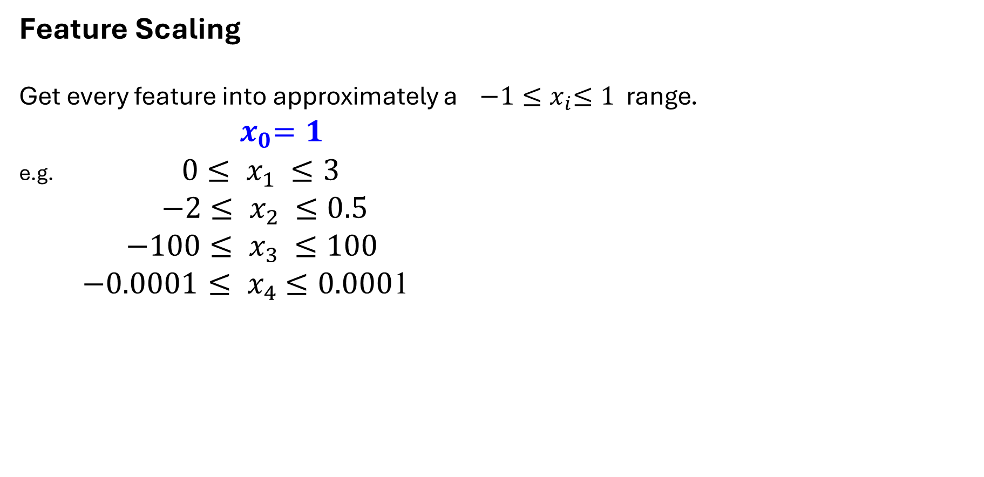
Feature Scaling
Get every feature into approximately a ${−1≤x}_{i}≤1$ range.
$${ x}_{0}=1$$
e.g. ${ 0≤ x}_{1} ≤3$
${ −2≤ x}_{2} ≤0.5$
${ −100≤ x}_{3} ≤100$
${−0.0001≤ x}_{4} ≤0.000$1

Slide 44
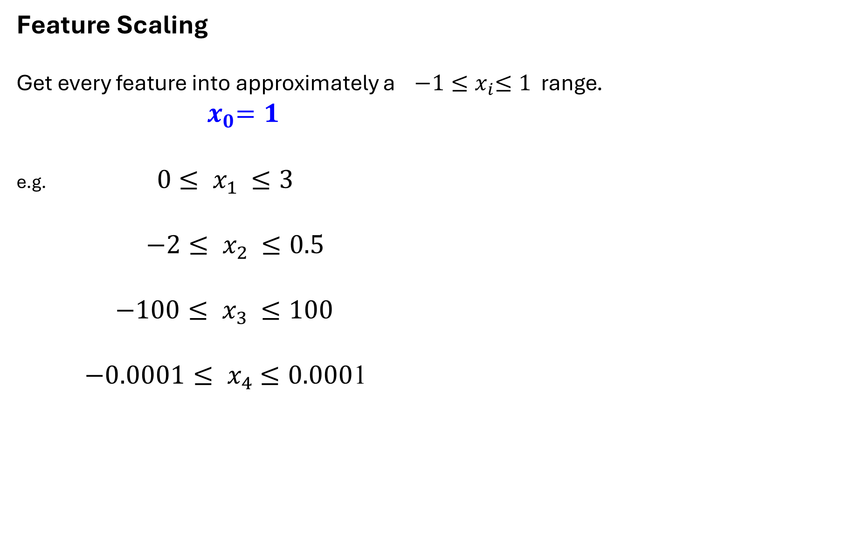

Feature Scaling
Get every feature into approximately a ${−1≤x}_{i}≤1$ range.
$${ x}_{0}=1$$
e.g. ${ 0≤ x}_{1} ≤3$
${ −2≤ x}_{2} ≤0.5$
${ −100≤ x}_{3} ≤100$
${−0.0001≤ x}_{4} ≤0.000$1

Slide 45
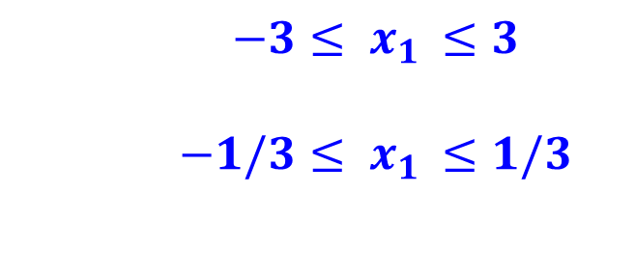
Feature Scaling
Get every feature into approximately a ${−1≤x}_{i}≤1$ range.
$${ x}_{0}=1$$
e.g. ${ 0≤ x}_{1} ≤3$
${ −2≤ x}_{2} ≤0.5$
${ −100≤ x}_{3} ≤100$
${−0.0001≤ x}_{4} ≤0.000$1
$${ −3≤ x}_{1} ≤3$$
$${ −1/3≤ x}_{1} ≤1/3$$

Slide 46
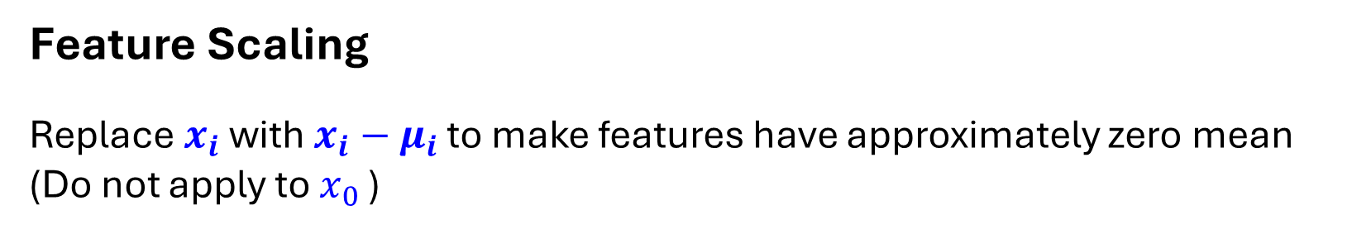
Feature Scaling
Replace $x_{i}$ with $x_{i}−μ_{i}$ to make features have approximately zero mean
(Do not apply to $x_{0}$ )

Slide 47
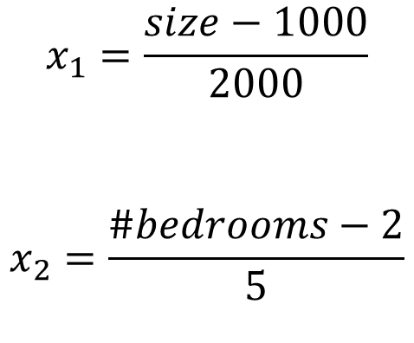
Feature Scaling
Replace $x_{i}$ with $x_{i}−μ_{i}$ to make features have approximately zero mean
(Do not apply to $x_{0}$ )
$$x_{1}=\frac{size−1000}{2000}$$
$$x_{2}=\frac{\#bedrooms−2}{5}$$

Slide 48
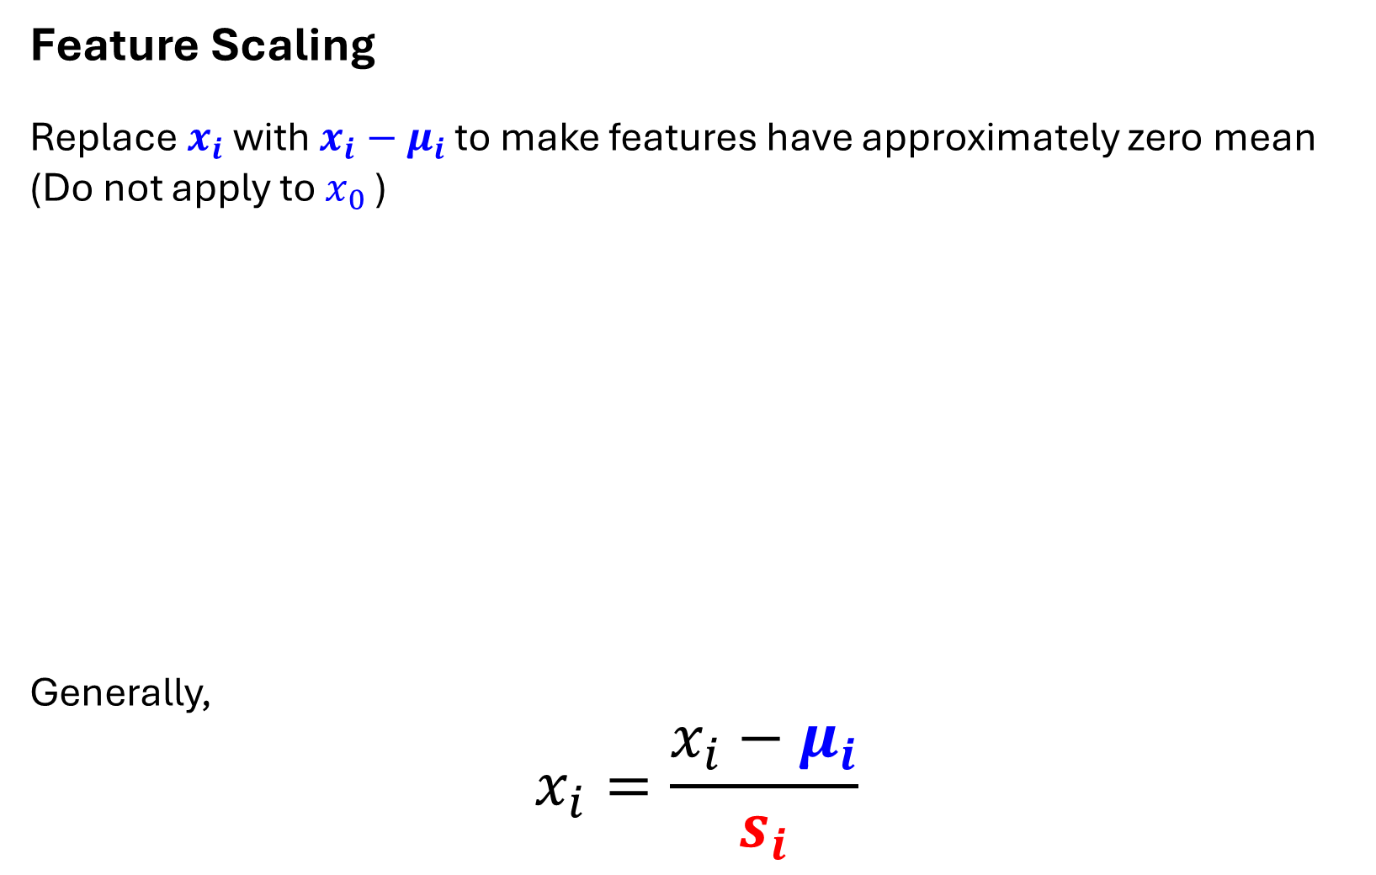
Feature Scaling
Replace $x_{i}$ with $x_{i}−μ_{i}$ to make features have approximately zero mean
(Do not apply to $x_{0}$ )
Generally,
$$x_{i}=\frac{x_{i}−μ_{i}}{s_{i}}$$
$$x_{1}=\frac{size−1000}{2000}$$
$$x_{2}=\frac{\#bedrooms−2}{5}$$

Slide 49
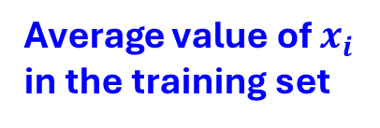
Feature Scaling
Replace $x_{i}$ with $x_{i}−μ_{i}$ to make features have approximately zero mean
(Do not apply to $x_{0}$ )
Generally,
$$x_{i}=\frac{x_{i}−μ_{i}}{s_{i}}$$
$$x_{1}=\frac{size−1000}{2000}$$
$$x_{2}=\frac{\#bedrooms−2}{5}$$
Average value of $x_{i}$
in the training set

Slide 50
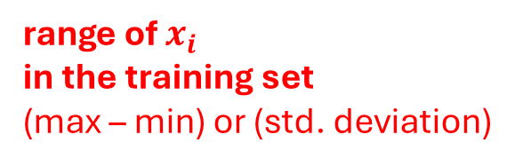
Feature Scaling
Replace $x_{i}$ with $x_{i}−μ_{i}$ to make features have approximately zero mean
(Do not apply to $x_{0}$ )
Generally,
$$x_{i}=\frac{x_{i}−μ_{i}}{s_{i}}$$
$$x_{1}=\frac{size−1000}{2000}$$
$$x_{2}=\frac{\#bedrooms−2}{5}$$
Average value of $x_{i}$
in the training set
range of $x_{i}$
in the training set
(max – min) or (std. deviation)

Slide 51
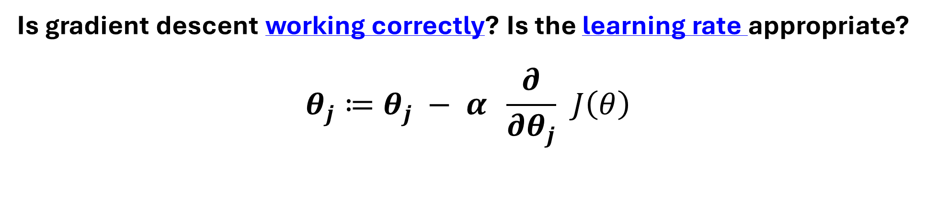
Is gradient descent working correctly? Is the learning rate appropriate?
$$θ_{j}≔θ_{j} − α \frac{∂}{∂θ_{j}} J\left(θ\right)$$

Slide 52
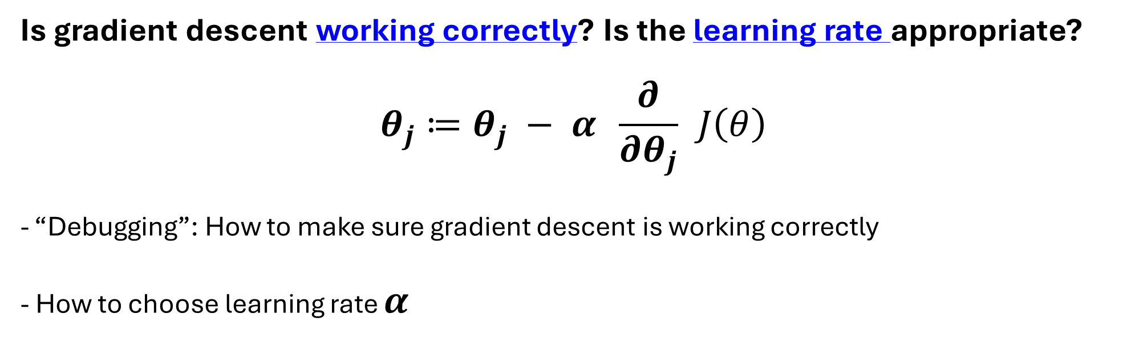
Is gradient descent working correctly? Is the learning rate appropriate?
$$θ_{j}≔θ_{j} − α \frac{∂}{∂θ_{j}} J\left(θ\right)$$
- “Debugging”: How to make sure gradient descent is working correctly
- How to choose learning rate $α$

Slide 53
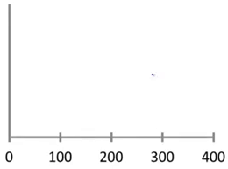

Is gradient descent working correctly?
$$\min_{θ}{J(θ)}$$
No. of iterations

Slide 54
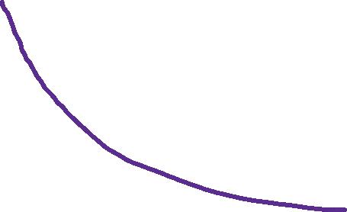
Is gradient descent working correctly?
$$\min_{θ}{J(θ)}$$
No. of iterations

Slide 55
Is gradient descent working correctly?
$$\min_{θ}{J(θ)}$$
$$J\left(θ\right) at θ that we get at iteration no. 100$$
No. of iterations

Slide 56
Is gradient descent working correctly?
$$\min_{θ}{J(θ)}$$
$$J\left(θ\right) at θ that we get at iteration no. 100$$
$$J\left(θ\right) at θ that we get at iteration no. 200$$
No. of iterations

Slide 57
Is gradient descent working correctly?
$$\min_{θ}{J(θ)}$$
$$J\left(θ\right) at θ that we get at iteration no. 100$$
$$J\left(θ\right) at θ that we get at iteration no. 200$$
$$J\left(θ\right) at θ that we get at iteration no. 300$$
No. of iterations

Slide 58
Is gradient descent working correctly?
$$\min_{θ}{J(θ)}$$
$$J\left(θ\right) at θ that we get at iteration no. 100$$
$$J\left(θ\right) at θ that we get at iteration no. 200$$
$$J\left(θ\right) at θ that we get at iteration no. 300$$
No. of iterations
Conclusion: If gradient descent is working properly, then $J(θ)$ must decrease after every iteration

Slide 59
Is gradient descent working correctly?
$$\min_{θ}{J(θ)}$$
$$J\left(θ\right) at θ that we get at iteration no. 100$$
$$J\left(θ\right) at θ that we get at iteration no. 200$$
$$J\left(θ\right) at θ that we get at iteration no. 300$$
No. of iterations
How many?
Conclusion: If gradient descent is working properly, then $J(θ)$ must decrease after every iteration

Slide 60
Is gradient descent working correctly?
$$\min_{θ}{J(θ)}$$
$$J\left(θ\right) at θ that we get at iteration no. 100$$
$$J\left(θ\right) at θ that we get at iteration no. 200$$
$$J\left(θ\right) at θ that we get at iteration no. 300$$
No. of iterations
How many? 30, 3000, 300,000 etc
Conclusion: If gradient descent is working properly, then $J(θ)$ must decrease after every iteration

Slide 61
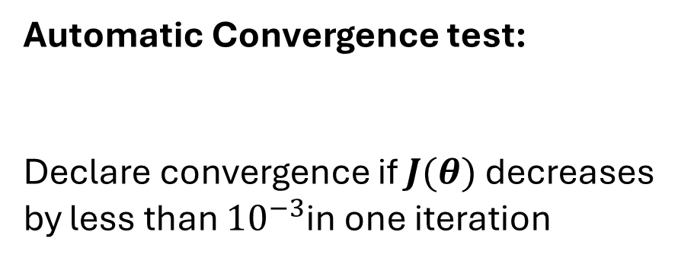
Is gradient descent working correctly?
$$\min_{θ}{J(θ)}$$
Automatic Convergence test:
Declare convergence if $J(θ)$ decreases
by less than ${10}^{−3}$in one iteration
No. of iterations
How many? 30, 3000, 300,000 etc
Conclusion: If gradient descent is working properly, then $J(θ)$ must decrease after every iteration

Slide 62
Is gradient descent working correctly?
$$\min_{θ}{J(θ)}$$
Automatic Convergence test:
Declare convergence if $J(θ)$ decreases
by less than ${10}^{−3}$in one iteration
Setting this threshold is often DIFFICULT
No. of iterations
How many? 30, 3000, 300,000 etc
Conclusion: If gradient descent is working properly, then $J(θ)$ must decrease after every iteration

Slide 63

Is gradient descent working correctly?
$$J(θ)$$
No. of iterations

Slide 64

Is gradient descent working correctly?
$$J(θ)$$
No. of iterations

Slide 65

Is gradient descent working correctly?
$$J(θ)$$
Gradient descent is not working properly
Use smaller LEARNING RATE (alpha)
No. of iterations
$$J(θ)$$

Slide 66





Is gradient descent working correctly?
$$J(θ)$$
Gradient descent is not working properly
Use smaller LEARNING RATE (alpha)
No. of iterations
$$J(θ)$$
$$J(θ)$$
No. of iterations

Slide 67
Is gradient descent working correctly?
$$J(θ)$$
Gradient descent is not working properly
Use smaller LEARNING RATE (alpha)
No. of iterations
$$J(θ)$$
$$J(θ)$$
No. of iterations

Slide 68
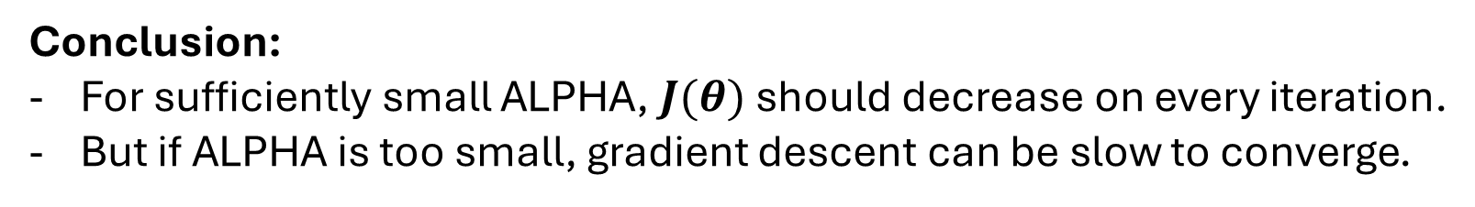
Is gradient descent working correctly?
$$J(θ)$$
Gradient descent is not working properly
Use smaller LEARNING RATE (alpha)
No. of iterations
$$J(θ)$$
$$J(θ)$$
No. of iterations
Conclusion:
For sufficiently small ALPHA, $J(θ)$ should decrease on every iteration.
But if ALPHA is too small, gradient descent can be slow to converge.

Slide 69
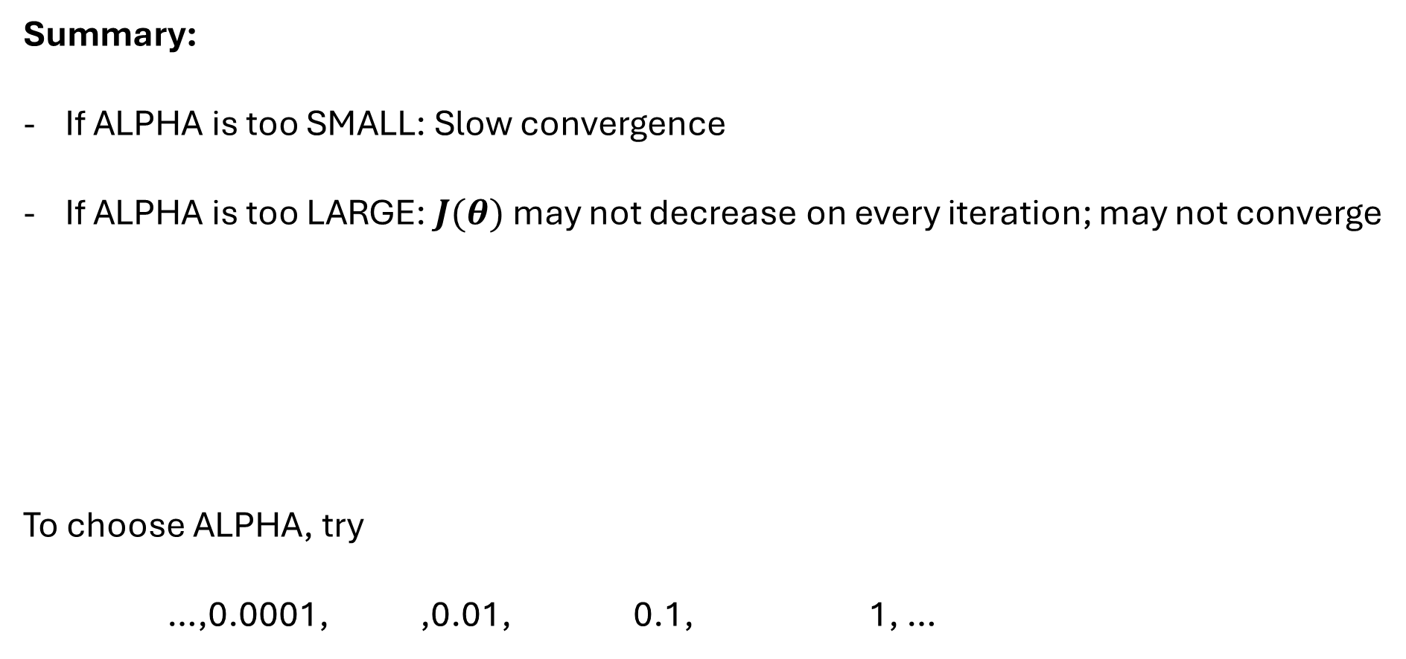
Summary:
If ALPHA is too SMALL: Slow convergence
If ALPHA is too LARGE: $J(θ)$ may not decrease on every iteration; may not converge
To choose ALPHA, try
…,0.0001, ,0.01, 0.1, 1, …

Slide 70
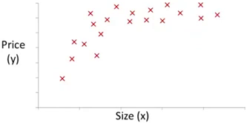
Polynomial regression

Slide 71

Polynomial regression
$$θ_{0}+θ_{1}x+θ_{2}x^{2}$$

Slide 72
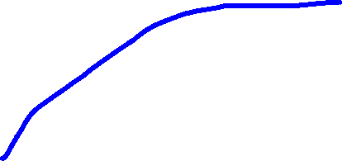
Polynomial regression
$$θ_{0}+θ_{1}x+θ_{2}x^{2}$$

Slide 73


Polynomial regression
$$θ_{0}+θ_{1}x+θ_{2}x^{2}$$

Slide 74

Polynomial regression
$$θ_{0}+θ_{1}x+θ_{2}x^{2}$$
$$θ_{0}+θ_{1}x+θ_{2}x^{2}{+θ}_{3}x^{3}$$

Slide 75

Polynomial regression
$$θ_{0}+θ_{1}x+θ_{2}x^{2}$$
$$θ_{0}+θ_{1}x+θ_{2}x^{2}{+θ}_{3}x^{3}$$

Slide 76

Polynomial regression
$$θ_{0}+θ_{1}x+θ_{2}x^{2}$$
$$θ_{0}+θ_{1}x+θ_{2}x^{2}{+θ}_{3}x^{3}$$

Slide 77
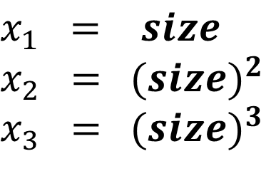
Polynomial regression
$$θ_{0}+θ_{1}x+θ_{2}x^{2}$$
$$θ_{0}+θ_{1}x+θ_{2}x^{2}{+θ}_{3}x^{3}$$
$h_{θ}\left(x\right)= θ_{0}+θ_{1}x+θ_{2}x^{2}$ ${+θ}_{3}x^{3}$
$$x_{1} = size$$
$$x_{2} ={ (size)}^{2}$$
$$x_{3} ={ (size)}^{3}$$

Slide 78
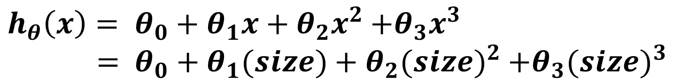
Polynomial regression
$$θ_{0}+θ_{1}x+θ_{2}x^{2}$$
$$θ_{0}+θ_{1}x+θ_{2}x^{2}{+θ}_{3}x^{3}$$
$h_{θ}\left(x\right)= θ_{0}+θ_{1}x+θ_{2}x^{2}$ ${+θ}_{3}x^{3}$
$= θ_{0}+θ_{1}(size)+θ_{2}{(size)}^{2}$ ${+θ}_{3}{(size)}^{3}$

Slide 79
Polynomial regression
$$θ_{0}+θ_{1}x+θ_{2}x^{2}$$
$$θ_{0}+θ_{1}x+θ_{2}x^{2}{+θ}_{3}x^{3}$$
$h_{θ}\left(x\right)= θ_{0}+θ_{1}x+θ_{2}x^{2}$ ${+θ}_{3}x^{3}$
$= θ_{0}+θ_{1}(size)+θ_{2}{(size)}^{2}$ ${+θ}_{3}{(size)}^{3}$
$$x_{1} = size$$
$$x_{2} ={ (size)}^{2}$$
$$x_{3} ={ (size)}^{3}$$

Slide 80
Polynomial regression
$$θ_{0}+θ_{1}x+θ_{2}x^{2}$$
$$θ_{0}+θ_{1}x+θ_{2}x^{2}{+θ}_{3}x^{3}$$
$h_{θ}\left(x\right)= θ_{0}+θ_{1}x+θ_{2}x^{2}$ ${+θ}_{3}x^{3}$
$= θ_{0}+θ_{1}(size)+θ_{2}{(size)}^{2}$ ${+θ}_{3}{(size)}^{3}$
$$x_{1} = size$$
$$x_{2} ={ (size)}^{2}$$
$$x_{3} ={ (size)}^{3}$$
1 – 1000
1 – 1000,000
1 – 1000,000,000

Slide 81
Polynomial regression
$$θ_{0}+θ_{1}x+θ_{2}x^{2}$$
$$θ_{0}+θ_{1}x+θ_{2}x^{2}{+θ}_{3}x^{3}$$
$h_{θ}\left(x\right)= θ_{0}+θ_{1}x+θ_{2}x^{2}$ ${+θ}_{3}x^{3}$
$= θ_{0}+θ_{1}(size)+θ_{2}{(size)}^{2}$ ${+θ}_{3}{(size)}^{3}$
$$x_{1} = size$$
$$x_{2} ={ (size)}^{2}$$
$$x_{3} ={ (size)}^{3}$$
1 – 1000
1 – 1000,000
Problem???
1 – 1000,000,000

Slide 82
Polynomial regression
$$θ_{0}+θ_{1}x+θ_{2}x^{2}$$
$$θ_{0}+θ_{1}x+θ_{2}x^{2}{+θ}_{3}x^{3}$$
$h_{θ}\left(x\right)= θ_{0}+θ_{1}x+θ_{2}x^{2}$ ${+θ}_{3}x^{3}$
$= θ_{0}+θ_{1}(size)+θ_{2}{(size)}^{2}$ ${+θ}_{3}{(size)}^{3}$
$$x_{1} = size$$
$$x_{2} ={ (size)}^{2}$$
$$x_{3} ={ (size)}^{3}$$
1 – 1000
1 – 1000,000
Feature Scaling
1 – 1000,000,000

